Slide 1
Stimulus-Response Model

Slide 2
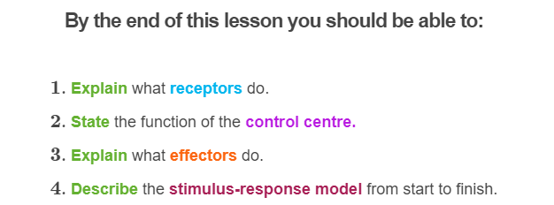

Slide 3
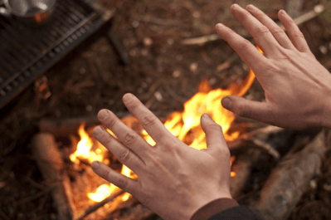
The model starts with a stimulus. A stimulus is anything the body senses.
For instance, if someone pokes you with a pencil, your body will sense the pressure the pencil exerts on your skin. Or, if you place your hand over a fire, you can feel the heat coming off of it.
In these examples, the pressure from the pencil and the heat from the object are both stimuli.

Slide 4
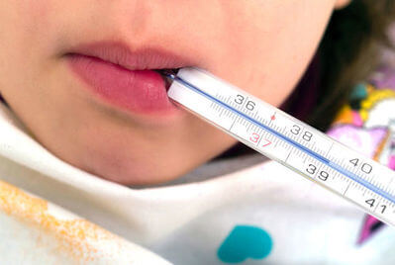
There are lots of different kinds of stimuli.
However, the important ones for homeostasis are the ones that deal with changes in the body's internal environment.
For instance, your body temperature could start to rise on a hot day. This rise in temperature is an important stimulus.

Slide 5
Stimuli are detected by receptors.
Receptors are organs and cells that detect changes in your external or internal environment. Humans have four types of receptors, each of which detect different types of stimuli.
Receptor | Stimulus | Example Locations
1. Photoreceptors | Light | Eyes
2. Mechanoreceptors | Mechanical forces, like pressure or vibrations | Ears and skin
3. Chemoreceptors | Concentration of chemicals | Tongue and nose
4. Thermoreceptors | Temperature | Skin and muscles

Slide 6
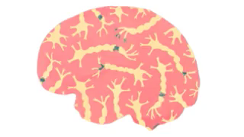
When a receptor detects a stimulus, it sends a message to the control centre.
The control centre then uses this information to decide what the body needs to do.
In most cases, the control centre is the brain. However, it can sometimes be other organs, such as the thyroid (a gland in the throat) or the pancreas (an organ near the stomach). What organ acts as the control centre depends on what kind of stimulus the body has detected.

Slide 7
Let's quickly review the first half of the stimulus-response model!
The body's internal environment changes. This change is called a stimulus. The stimulus is detected by a receptor.
The receptor then sends information to the control centre, which decides what the body needs to do.

Slide 8
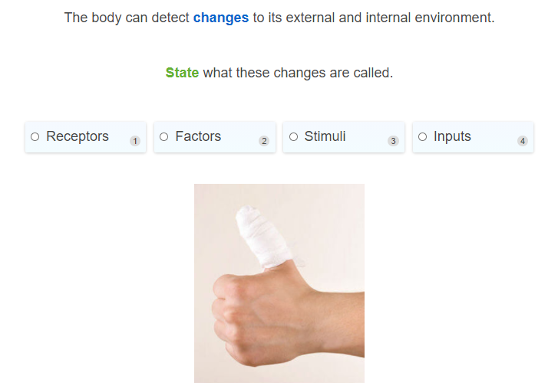

Slide 9
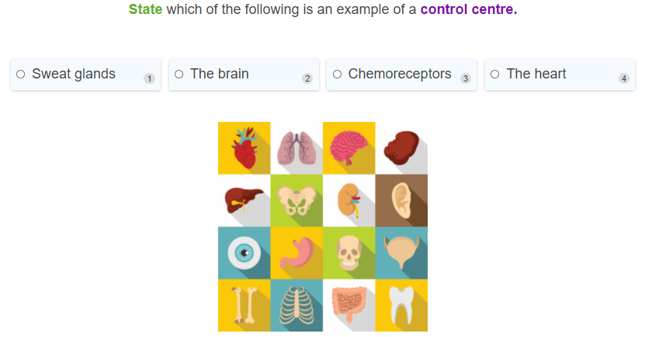

Slide 10
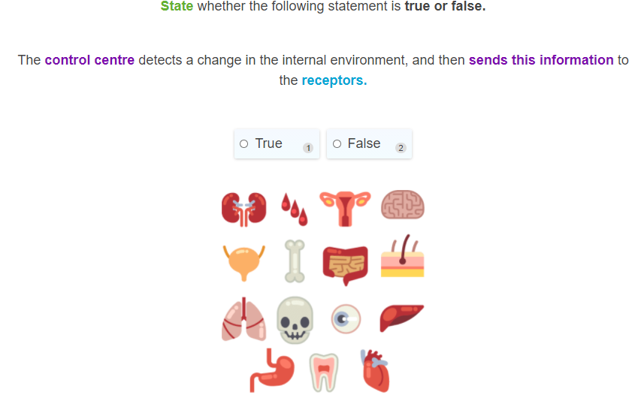

Slide 11
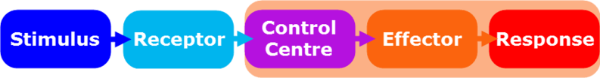
In the first half of the stimulus-response model, the body detects a change to its internal environment.
Now we will learn how it responds to this change.

Slide 12
As you already know, the control centre receives information from receptors about the body's internal environment.
Using this information, it can determine what actions the body needs to take to maintain homeostasis.

Slide 13
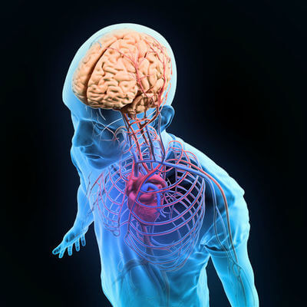
Once the control centre has decided what the appropriate course of action is, it sends a signal to the parts of the body that can carry out this action.
These parts of the body are called effectors, because they effect (cause) the body's response.

Slide 14
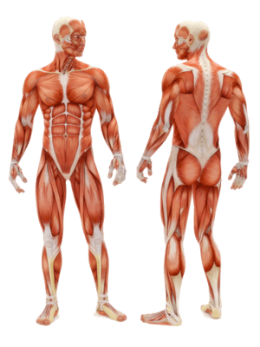
Effectors come in many shapes and sizes.
Muscles are a classic effector. They can move you to a safer environment, control your blood pressure by changing the size of your blood vessels, or warm you up by making you shiver.

Slide 15
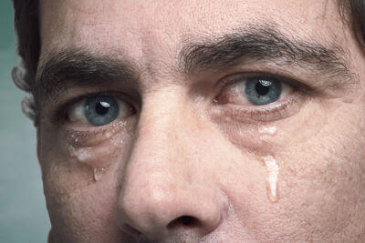
You have glands throughout your body that produce important substances.
Sweat, for instance, is produced by glands in your skin, while tears are made by glands next to your eyes.

Slide 16
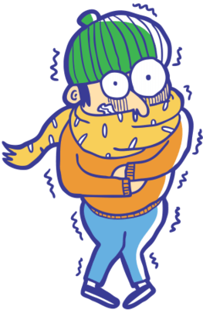
The effector's job is to carry out the body's response.
This response will act against whatever changes have occurred in the stable internal environment. This way, the internal environment is kept stable.
For example, when your body temperature drops, your muscles shiver. This produces heat and warms you back up. In this case, the muscles are the effectors and shivering is the response.

Slide 17
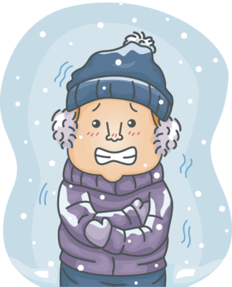
Keep in mind that your body can use many different effectors and responses to deal with the same issue.
For example, to stop your body temperature from dropping on a cold day, your muscles can shiver to produce heat. The blood vessels in your skin, hands and feet can also constrict (become skinner). This keeps the majority of your blood near the centre of your body, where the cold air cannot steal heat from it.

Slide 18
Let’s quickly recap the second half of the stimulus-response model.
The control centre decides what the body needs to do in order to maintain homeostasis. It then sends commands to one or more effectors.
These effectors produce responses that act against changes in the internal environment, thereby keeping the internal environment stable.

Slide 19
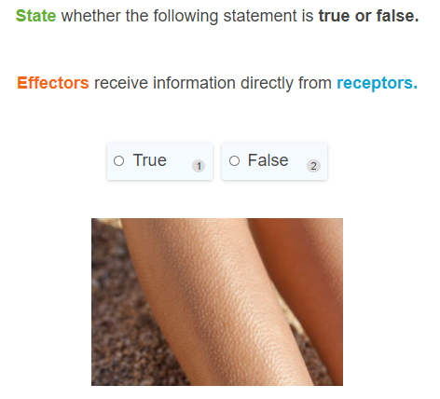

Slide 20
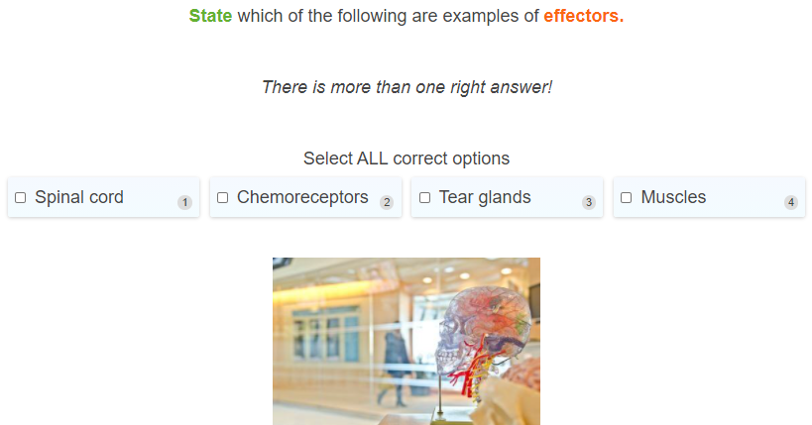

Slide 21
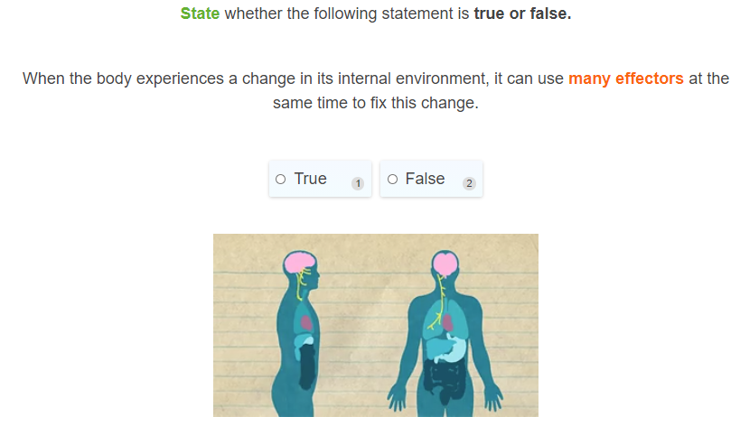

Slide 22
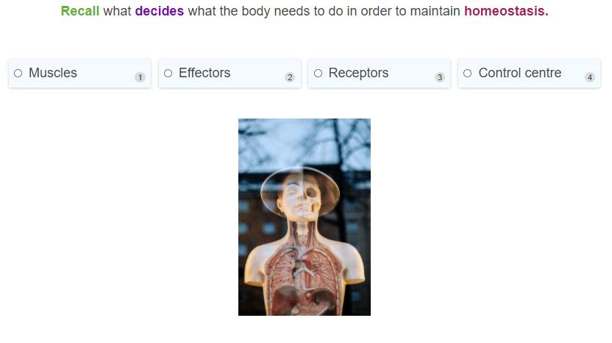

Slide 23
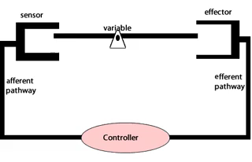
Let's put together everything we have learnt about the stimulus-response model!

Slide 24
First, receptors detect a change in the body's internal environment. This change is called a stimulus.

Slide 25
Then, the receptors send a message to the control centre.
The control centre processes the message and decides what the body needs to do in order to maintain homeostasis.
The control centre is usually the brain, but it can be a different organ depending on what stimulus the body has detected.

Slide 26
The control centre sends commands out to effectors, which carry out the appropriate responses.
These responses counteract the initial change in the internal environment. This keeps the internal environment stable and maintains homeostasis.

Slide 27
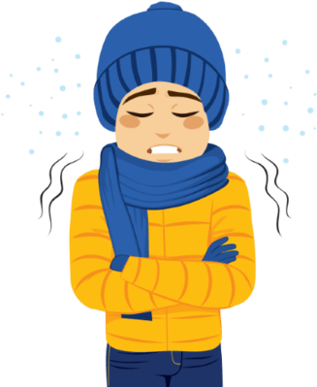
Let's look at a quick example.
On a cold day, your body temperature starts to cool down. Thermoreceptors detect this stimulus, and send a message to a part of the brain called the hypothalamus. The hypothalamus processes the message and sends a command out to your muscles, telling them to shiver. The shivering produces heat, which keeps you warm.

Slide 28
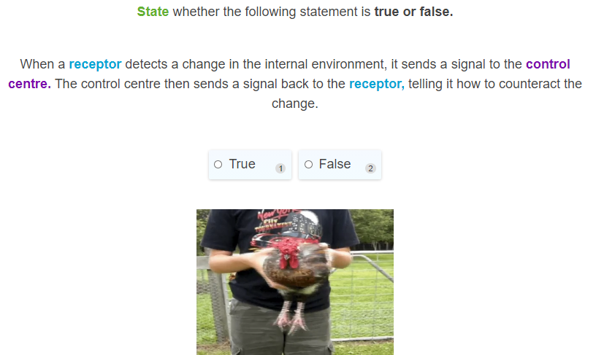

Slide 29
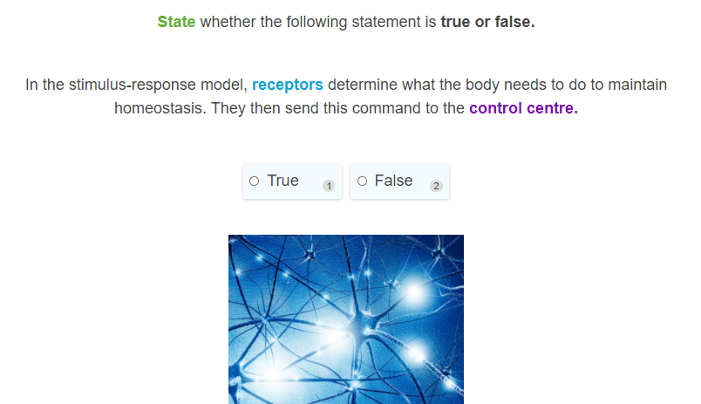

Slide 30
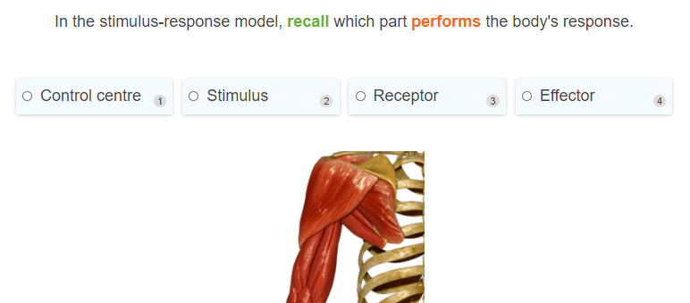

Slide 31
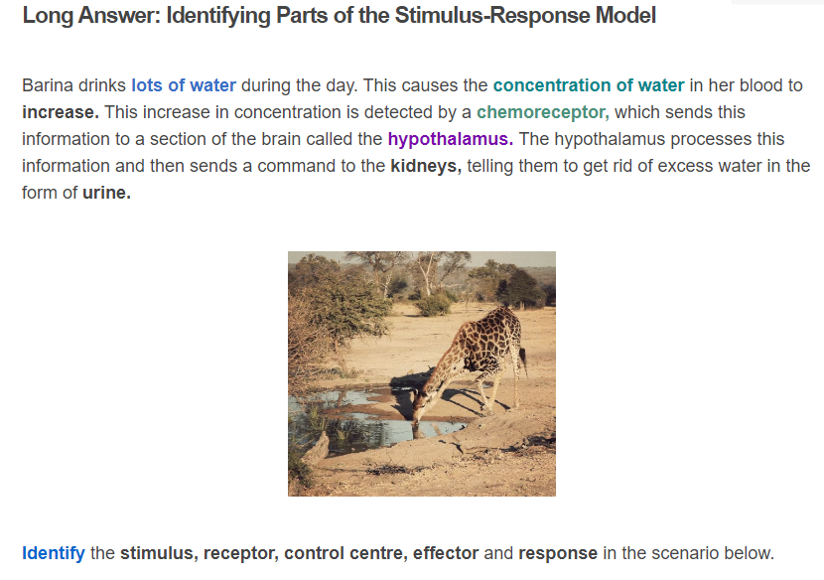

Slide 32
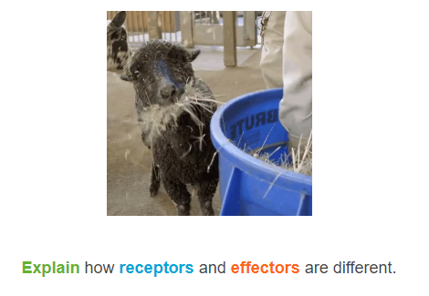

Slide 33
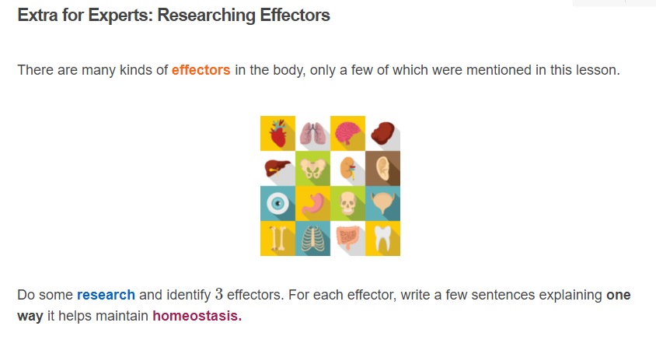

Slide 34
